Slide 1
Introduction to bulk RNA-seq analysis
13 March 2025

Slide 2
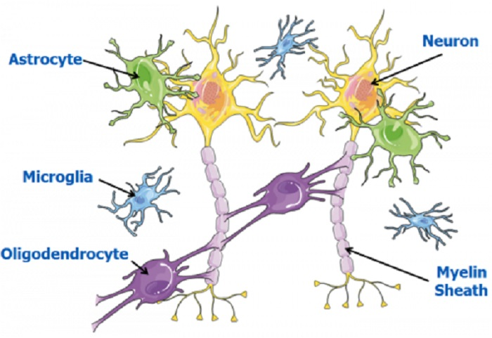
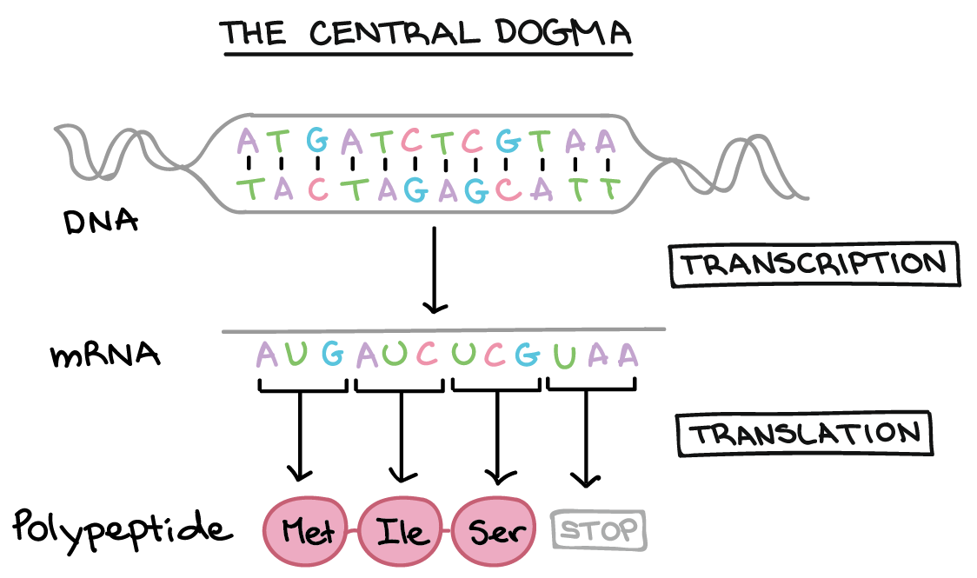
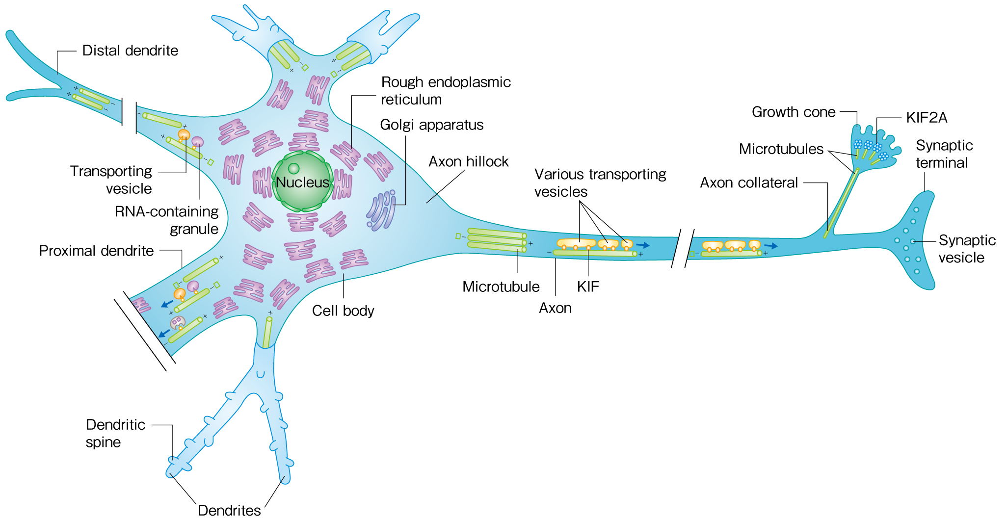
Molecular measurements of tissue
Hirokawa, 2018
Objective: Quantify relative mRNA (or protein) levels in brain tissue

Slide 3
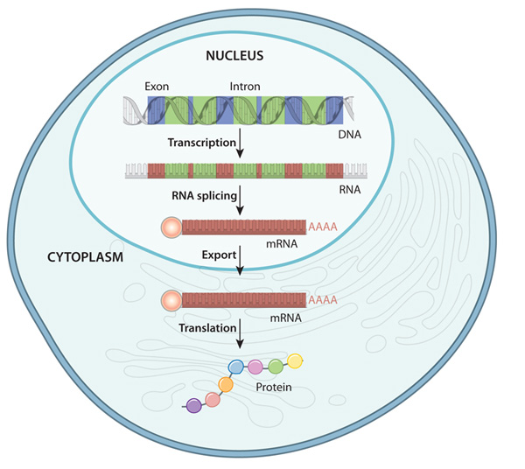
Why study transcription?
nature.com
nature.com/scitable/topicpage/gene-expression-14121669/

Slide 4
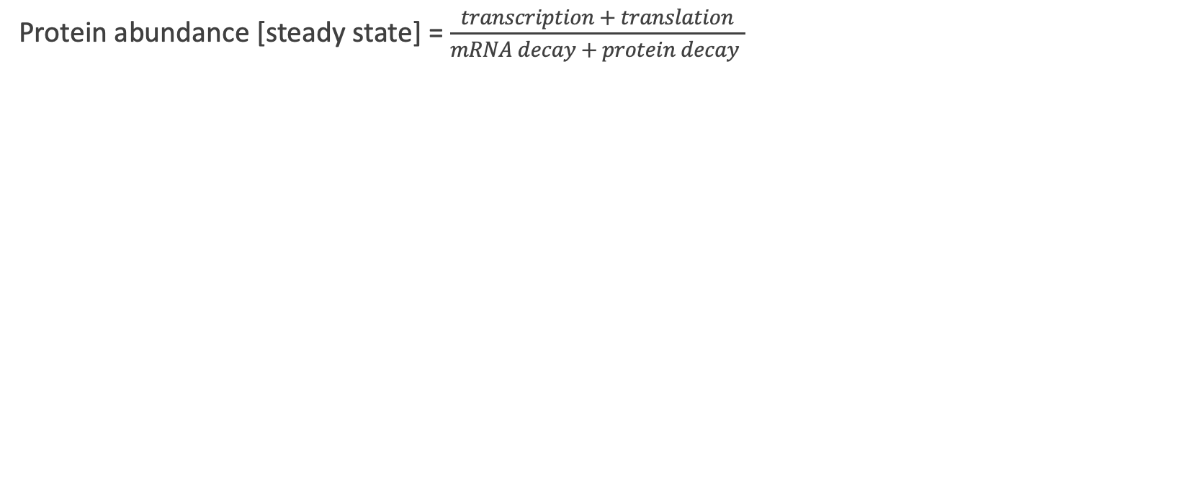
Why study transcription?
Protein abundance [steady state] =$\frac{transcription + translation}{mRNA decay + protein decay }$

Slide 5
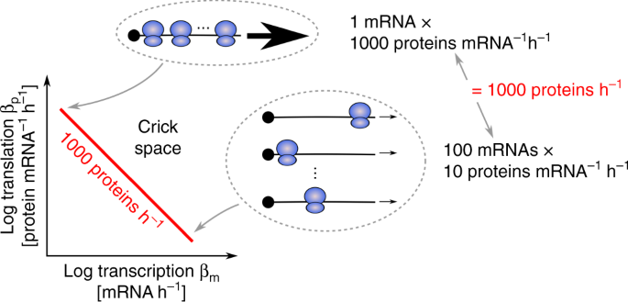
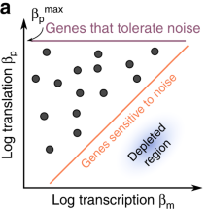
Why study transcription?
Protein abundance [steady state] =$\frac{transcription + translation}{mRNA decay + protein decay }$
Hausser et al (2019)

Slide 6
Considerations for molecular profiling of brain tissue
How many molecules do we want to measure?
What degree of cellular resolution do we want?
How many samples do we want to profile?
What spatial resolution (if any) do we need?
What is the throughput/cost?
How has the tissue been preserved?

Slide 7
Refresher – molecular profiling methods
 | ISH/IHC | Microarray | RNA-seq
# of genes/proteins at once | ~1 – 5 (~500 with advanced methods) | ~10,000 – 20,000 | ~10,000 – 20,000
Single-cell resolution | Yes | No | No
Spatial information | Yes | No | No
“Unbiased” (no pre-selection) | No | Mostly (genome-wide selection of probes) | Yes

Slide 8
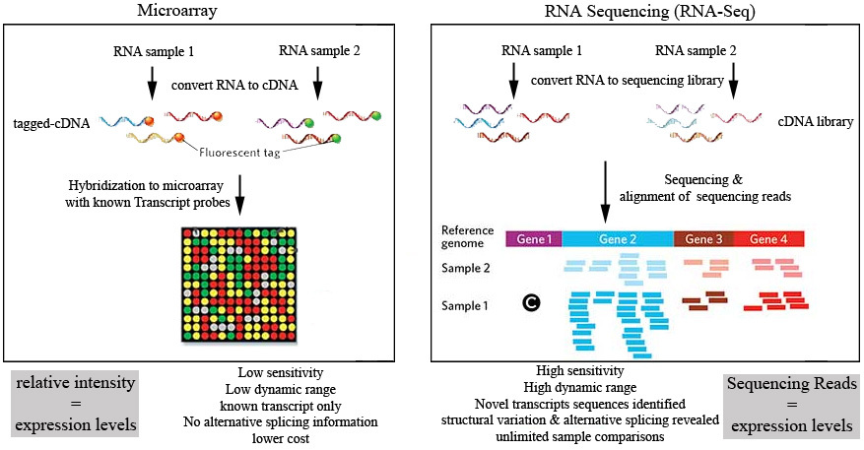
Large-scale transcriptomics
$100-350 per sample
$300-1000 per sample

Slide 9

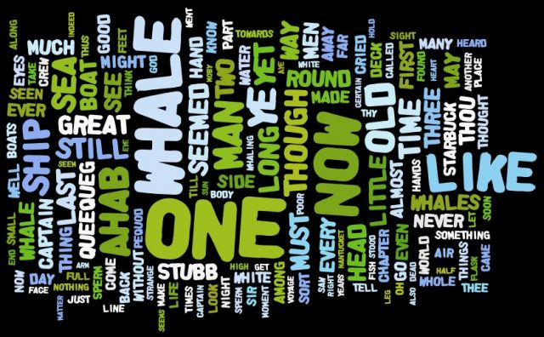
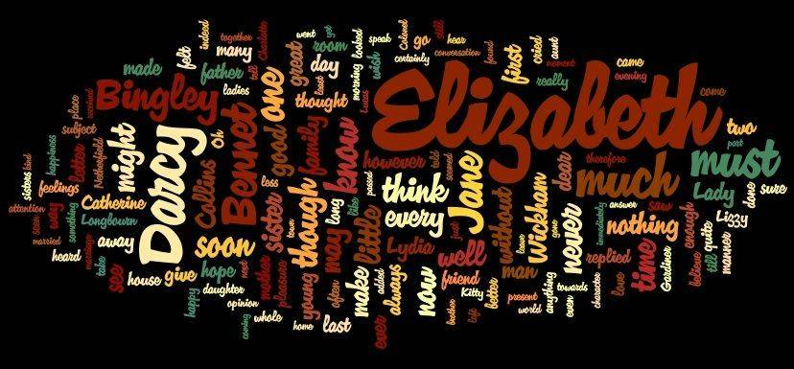
What are we measuring in RNA-seq?
The Art of Clean Up, Ursus Wehrli

Slide 10
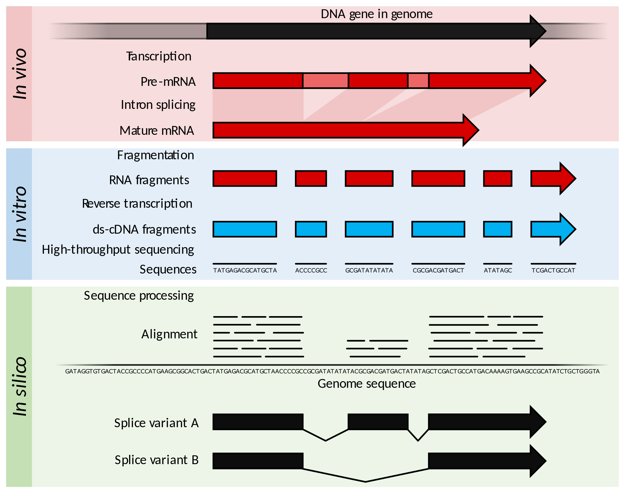
RNA-sequencing overview
Wikipedia

Slide 11
Analyzing bulk RNA-seq – general workflow
Transcriptome alignment
QC & batch correction
Normalization
Downstream analyses
Expression quantification
http://master.bioconductor.org/packages/release/workflows/vignettes/rnaseqGene/inst/doc/rnaseqGene.html
(Michael Love, Simon Anders, Vladislav Kim, Wolfgang Huber)

Slide 12
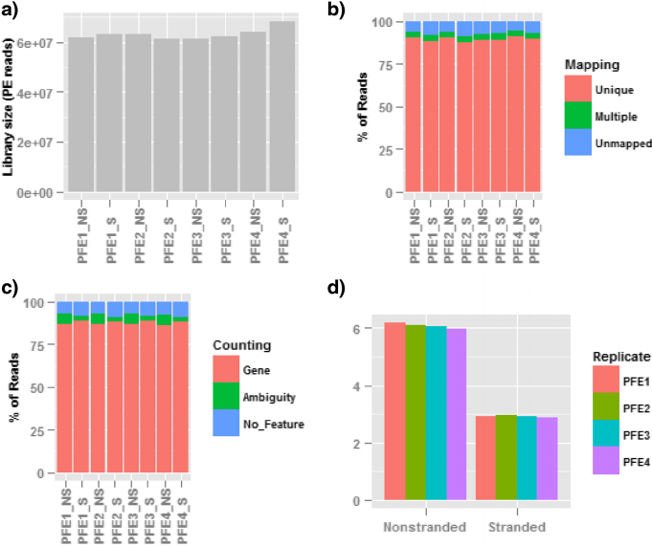
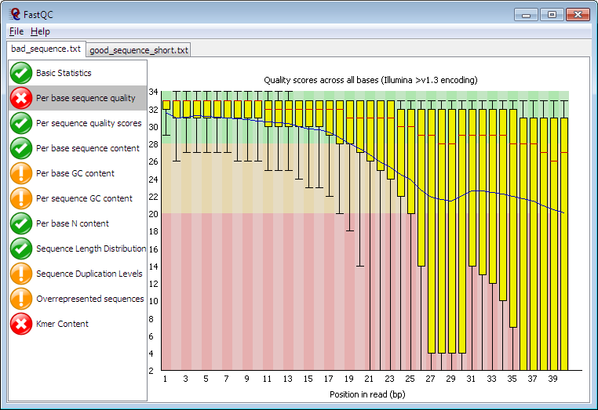
Bulk RNA-seq QC and batch correction
Common QC metrics
Total reads per library
GC bias
Per-base sequencing quality
Percentage of reads mapped
Reads mapping to genomic features
Batch correction
When batches are known:
Gene-by-gene regression by batch identity
ComBat (Empirical Bayes approach)
When unknown effects need to be accounted for:
Surrogate variable analysis (SVA)
RUVseq (Factor-based analysis)
Zhao et al. (2014)
Babraham Bioinformatics

Slide 13
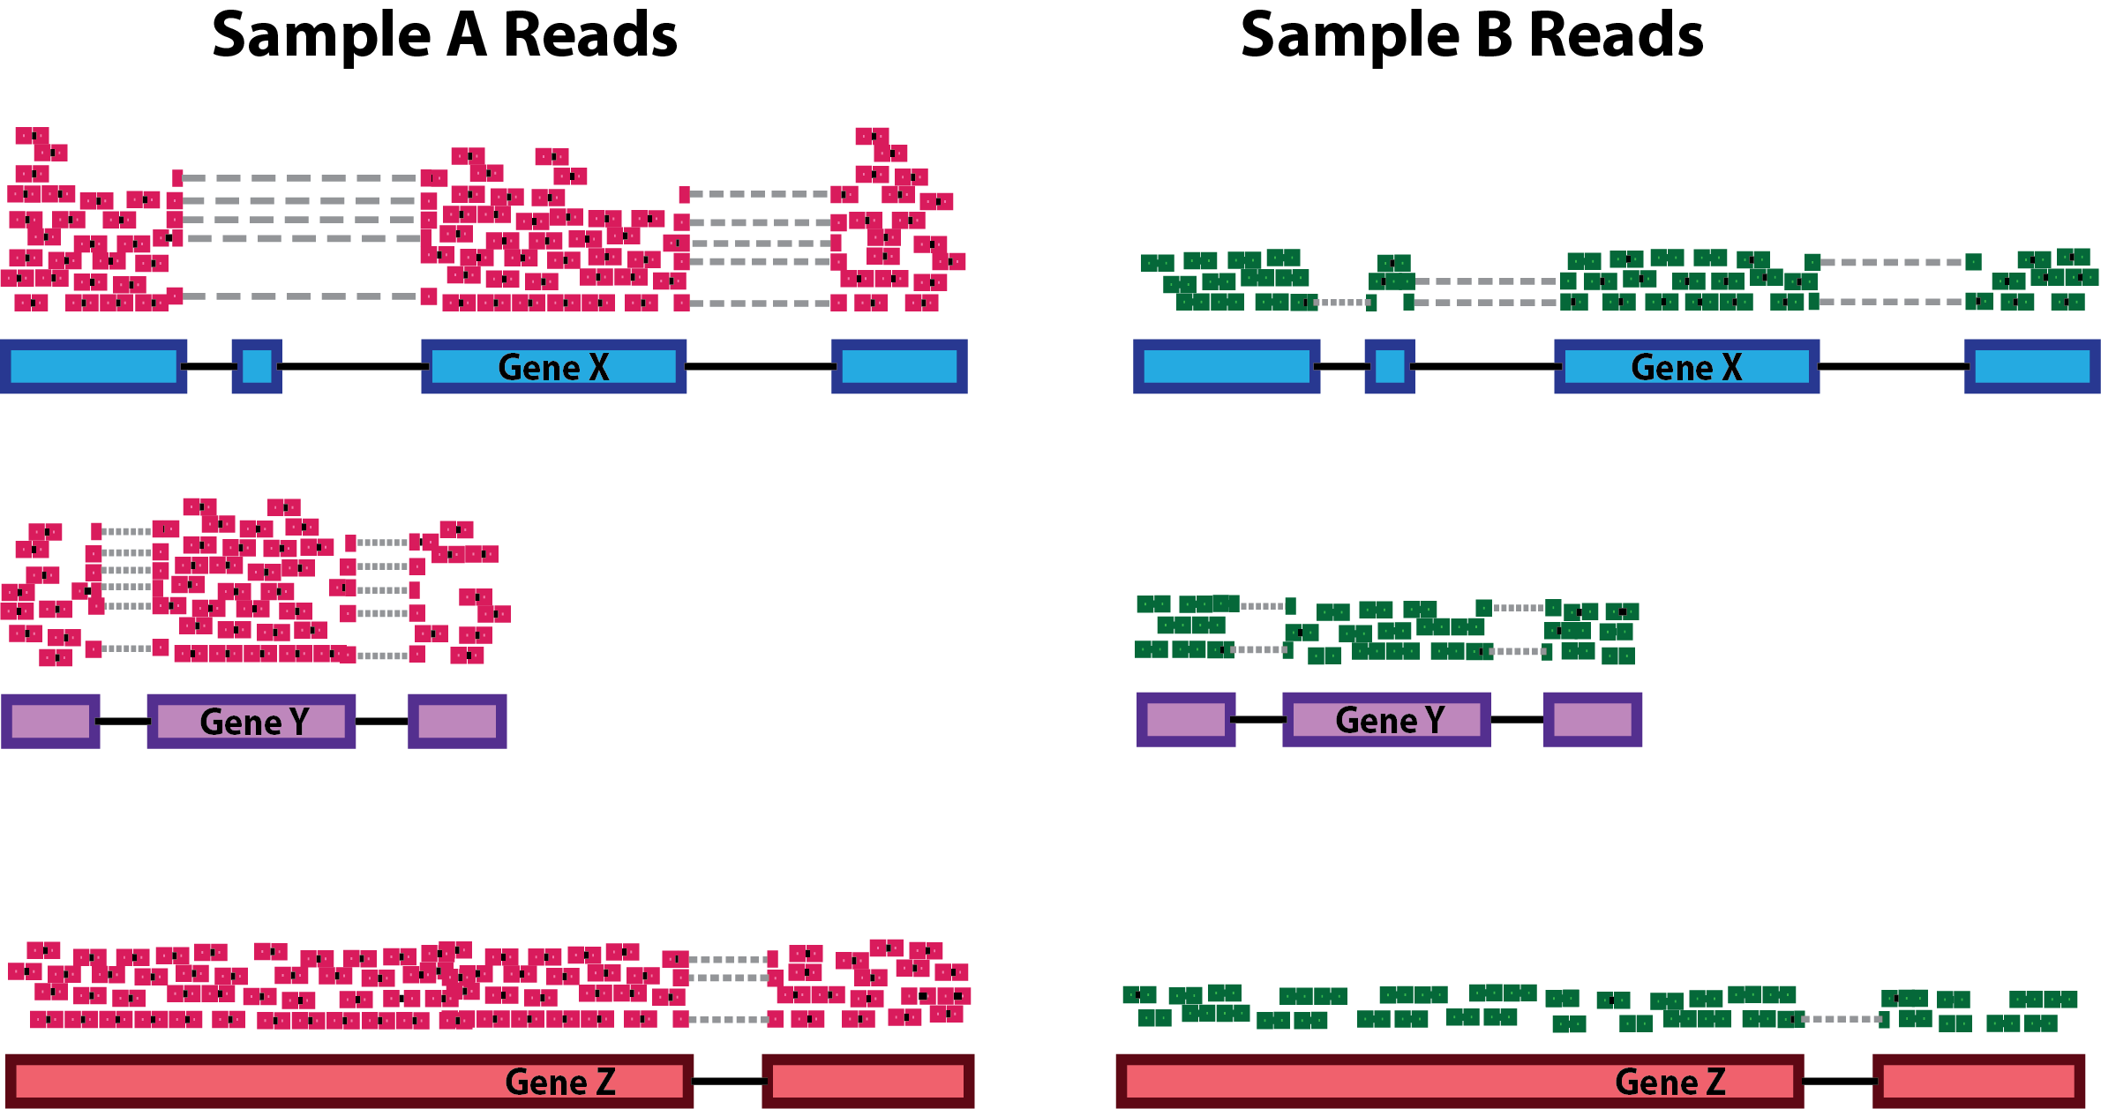
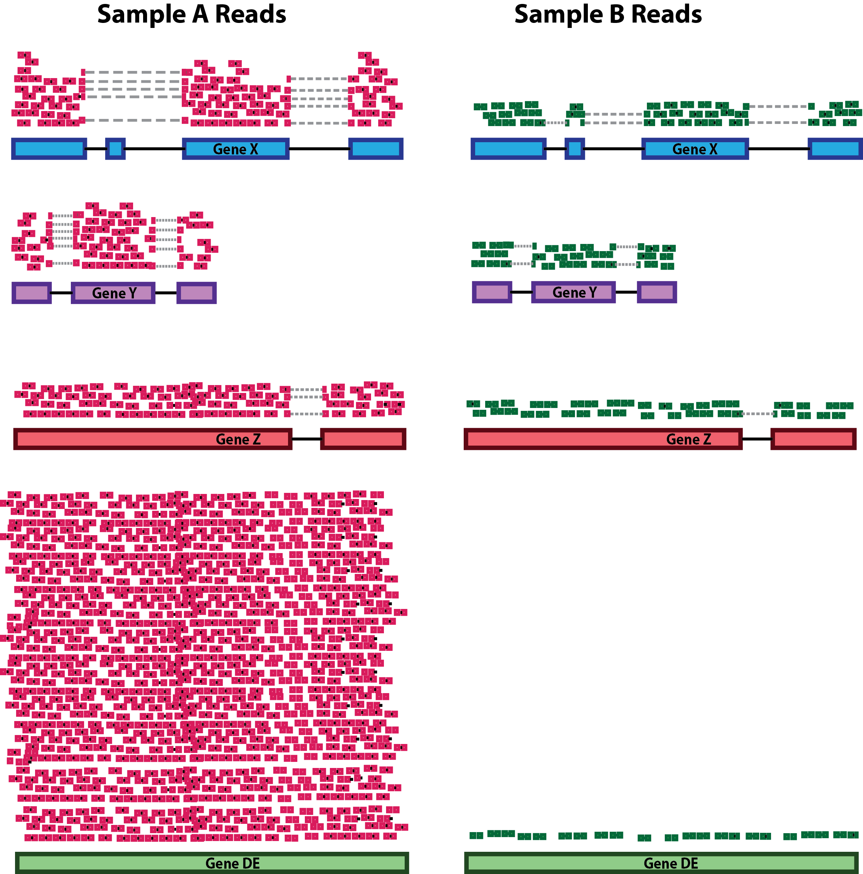
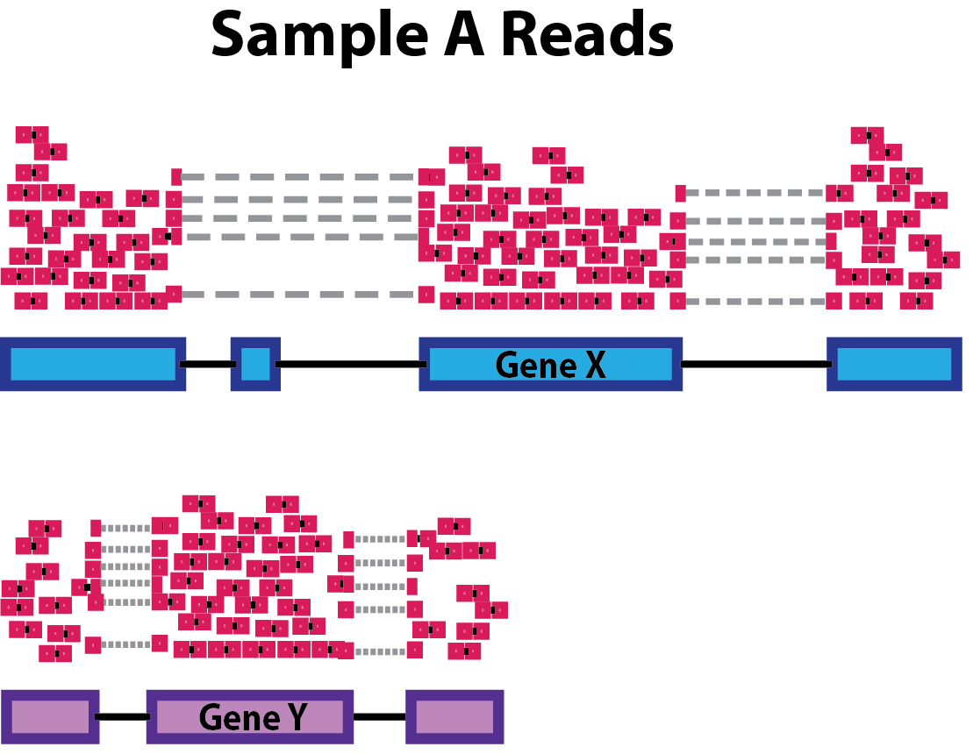
Data normalization considerations
Accounting for sequencing depth
Accounting for overall composition
Accounting for gene length
(not common currently)
Harvard Chan Bioinformatics Core
https://hbctraining.github.io/DGE_workshop/lessons/02_DGE_count_normalization.html

Slide 14
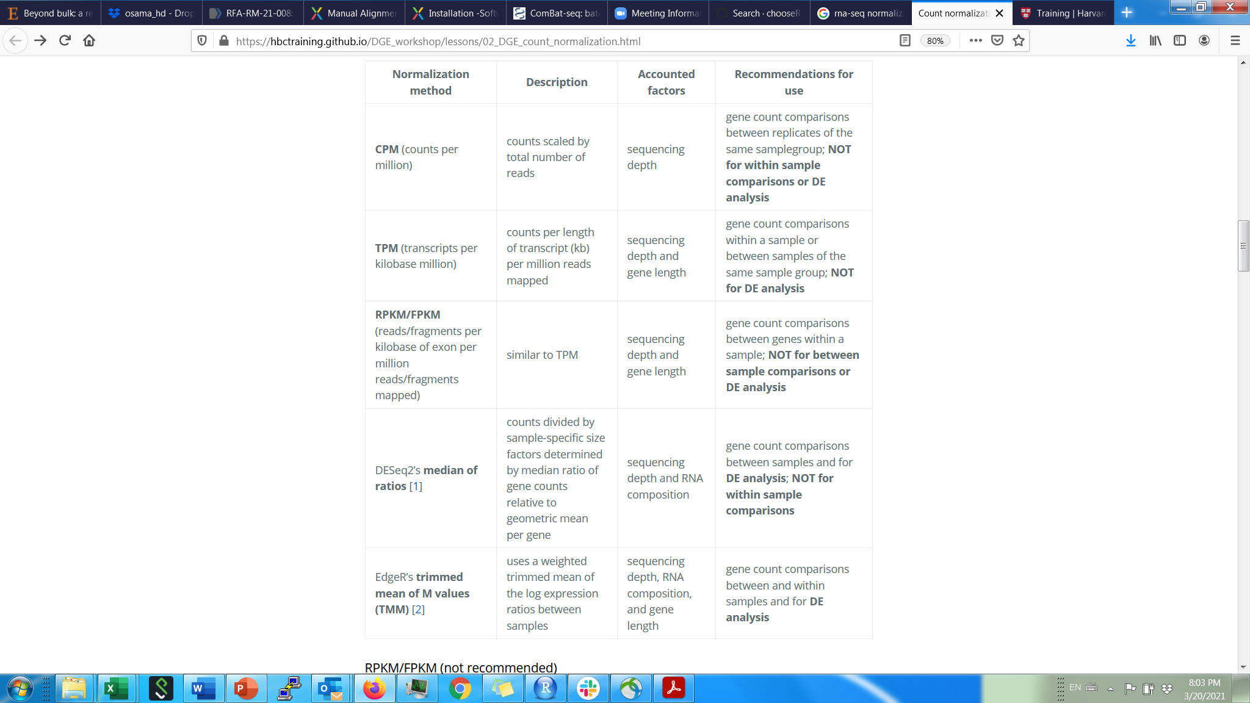
Harvard Chan Bioinformatics Core
https://hbctraining.github.io/DGE_workshop/lessons/02_DGE_count_normalization.html

Slide 15


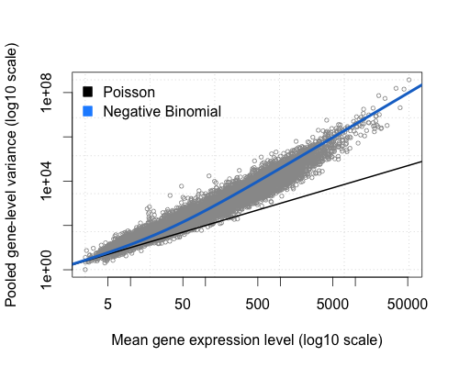

Differential expression - statistical modeling of RNA count data
Trials (n)
Successes (p)
Sampling with replacement
(binomial distribution)
Poisson distribution
(binomial with large n, small p)
Sample 1 (reads)
Full set of transcripts
Sample 2 (reads)
Negative binomial distribution

Slide 16
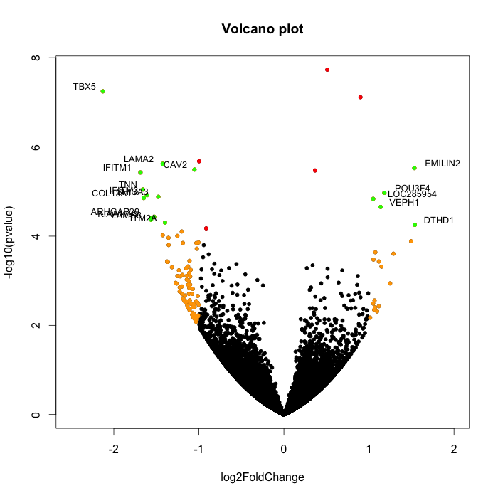
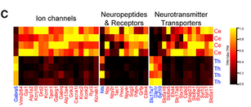
Bulk RNA-seq differential expression visualization
Common DEG packages:
edgeR
DESeq2
limma

Slide 17

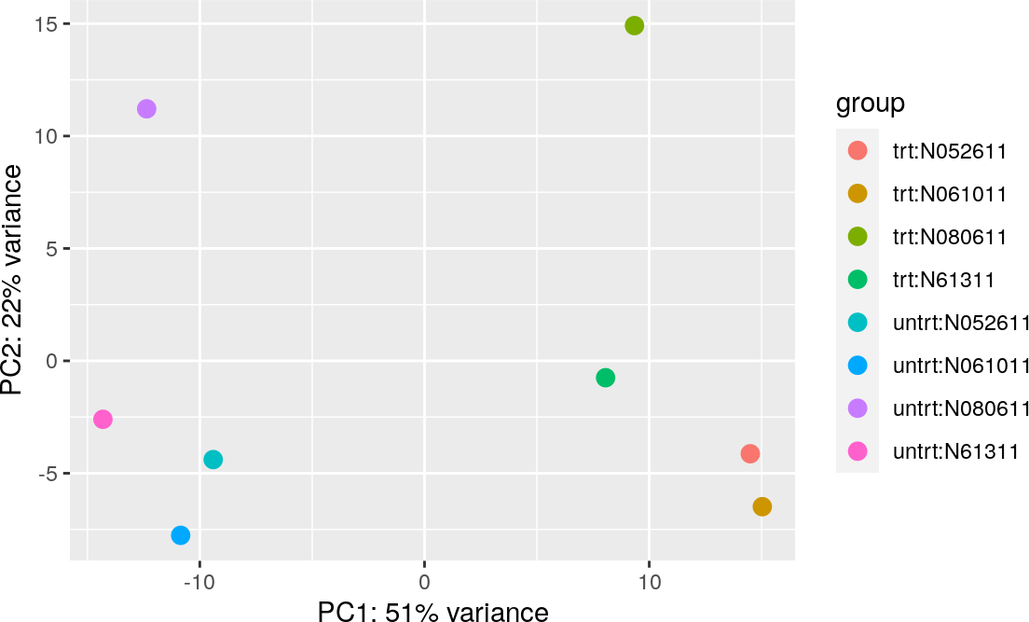
Exploratory analysis - PCA

Slide 18
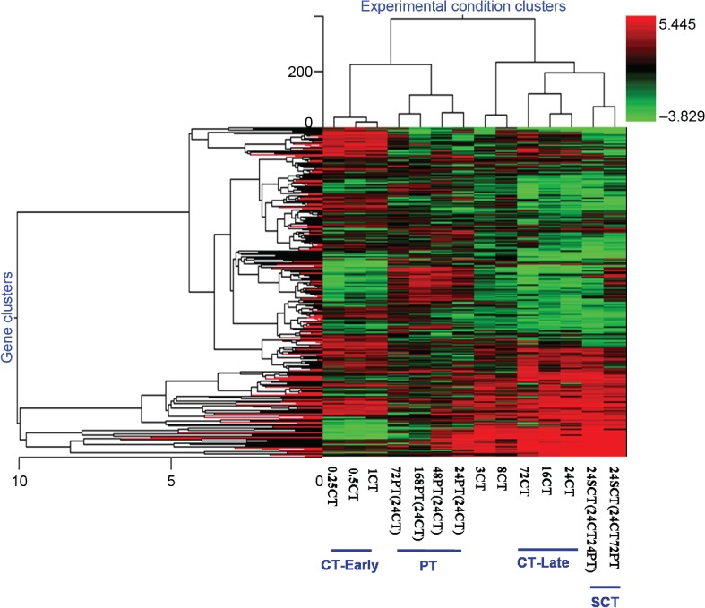
Unsupervised analysis: Gene and sample clustering

Slide 19
Unsupervised analysis: Gene and sample clustering
Identify further structure in the data, especially if samples are not easily grouped into categories
Clustering requires:
A distance metric
An algorithm to assign elements to groups
Gene clusters (“modules”) highlight co-expression patterns
With sufficiently large sample numbers, can use:
K-means clustering
Standard hierarchical clustering
Weighted Gene Co-expression Network Analysis (WGCNA)
De novo gene clusters can be used for pathway analysis

Slide 20
Summary of bulk RNA-seq analysis
Transcriptome alignment
QC & batch correction
Normalization
Downstream analyses
Expression quantification
Exploratory Analysis
(e.g. PCA)
Unsupervised approaches (gene clustering)
Integrated interpretation
Differential gene expression

Slide 21
Workshop Part 1 – Bulk RNA-seq differential expression workflow

Slide 22
Part 2 - Experimental design and the challenges of confounders in “omics” data
Good experimental design:
Minimizes the effects of “things we do not care about” (Confounders/confounding variables)
Includes controls to estimate the effect of the treatment vs. confounders.
Randomizes variables that we cannot control
OMICS experiments measure thousands of events simultaneously, and a variety of technical and biological confounders can affect the measurements.

Slide 23
How can we account for confounders? Identify unwanted sources of variation
Are (biological/technical) replicates more similar to each other than they are to samples from other conditions?
Do samples have comparable dynamic ranges?
When you do differential expression are your p-value distributions mostly uniform?
Do you have controls, how do they behave?
There is no one-size-fits-all analysis pipeline

Slide 24
Important considerations for overcoming challenges
Good experimental design is crucial
Known your variables and your controls
Don’t introduce too many variables at once
e.g: understand “typical” response before investigating “atypical”
Biology is biology regardless of technology
A new technology should does not erase previous knowledge
Use prior knowledge to your advantage
e.g: Microrray-> RNA-seq ->snRNA-seq

Slide 25
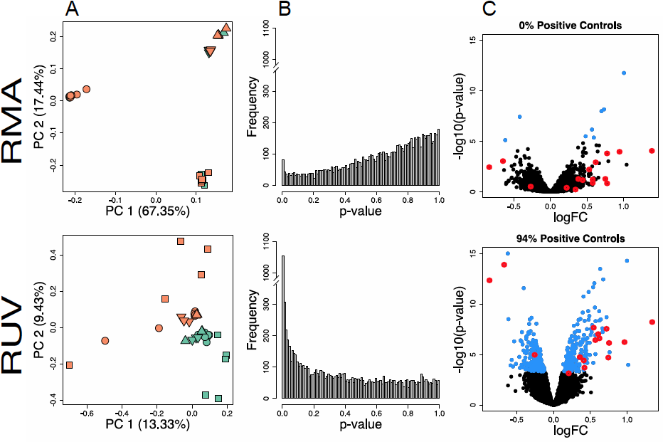
Proper accounting for confounders allows for reproducible results across microarray studies
Gerstner et al. BMC Genomics 2016

Slide 26
Statistical modelling for differential gene expression analysis
Generalized linear model for differential expression (edgeR or DESeq2)
Effect of treatment on expression
Observed expression
Random error
=
+
Remove Unwanted Variance for sequencing (RUV-seq): Risso et al, Nature Biotechnology, 2014
Effect of treatment on expression
Effect of k confounding factors
Observed expression
Random error
=
+
+
We take a linear model and turn it into a mixed-effects model
We do not directly normalize the expression matrix,
the confounders are removed by modeling them as a term in the linear equation used for differential expression
Notes:
RUV-seq is available thorugh R/Bioconductor, author Davide Risso

Slide 27
Workshop Part 2 – Accounting for confounders in differential expression analysis

Slide 28
Resources: References
Sequencing technology does not eliminate biological variability. https://www.ncbi.nlm.nih.gov/pmc/articles/PMC3137276/
How data analysis affects power, reproducibility and biological insight of RNA-seq studies in complex datasets. https://www.ncbi.nlm.nih.gov/pmc/articles/PMC4652761/
Orchestrating high-throughput genomic analysis with Bioconductor. https://pubmed.ncbi.nlm.nih.gov/25633503/
Alignment and mapping methodology. https://genomebiology.biomedcentral.com/articles/10.1186/s13059-020-02151-8
muscat detects subpopulation-specific state transitions from multi-sample multi-condition single-cell transcriptomics data https://pubmed.ncbi.nlm.nih.gov/33257685/
Confronting false discoveries in single-cell analysis https://www.nature.com/articles/s41467-021-25960-2#Sec10

Slide 29
Resources: BioC manuals for packages we will use
EDAseq
https://bioconductor.org/packages/release/bioc/html/EDASeq.html
RUVSeq
https://bioconductor.org/packages/release/bioc/html/RUVSeq.html
EdgeR
https://bioconductor.org/packages/release/bioc/html/edgeR.html

Slide 30
Part 3 - Downstream analysis with gene sets
You have your list of differentially expressed genes. Is this list enriched for any genes of interest?
How would you define genes of interest?
Examples of “interesting” categories
Cell types
Pathways
Biological processes
Cellular compartments
Disease risk genes
Custom gene sets that you have created

Slide 31
Two approaches to test for enrichment
Hypergeometric test: overlap of two sets
Requires a list of genes
Example: DEGs thresholded by p-value
Underlies the Fisher’s exact test
Gene set enrichment analysis: enrichment within ordered set
Requires all genes to be ranked
Example: genes ranked by fold-change

Slide 32
Hypergeometric distribution
Model: sampling from a set without replacement
How likely is it to draw this combination of objects?

Slide 33
Applying the hypergeometric test to gene sets
Basic question:
In my differential gene list, how likely is it to see (at least) a specific number of genes belonging to a certain category?
My DEG list has 5 genes
4 of these genes belong to the set of interest
If I picked 5 genes randomly (instead of by DE), how likely would I be to get 4 or more genes from the set of interest?
Gene set of interest
Other (“background”) genes

Slide 34
Group exercise: hypergeometric distribution
# of genes | # of instances
0
1
2
3
4
5
6
7
8
9
10

Slide 35
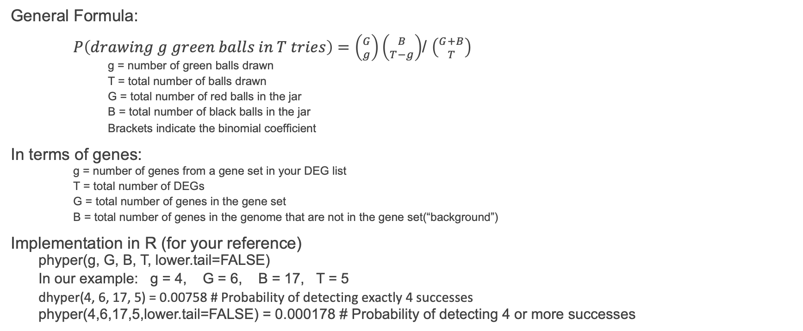
Calculating the hypergeometric test p-value
General Formula:
$P\left(drawing g green balls in T tries\right)=\left({G \atop g}\right)\left({B \atop T−g}\right)$/ $\left({G+B \atop T}\right)$
g = number of green balls drawn
T = total number of balls drawn
G = total number of red balls in the jar
B = total number of black balls in the jar
Brackets indicate the binomial coefficient
In terms of genes:
g = number of genes from a gene set in your DEG list
T = total number of DEGs
G = total number of genes in the gene set
B = total number of genes in the genome that are not in the gene set(“background”)
Implementation in R (for your reference)
phyper(g, G, B, T, lower.tail=FALSE)
In our example: g = 4, G = 6, B = 17, T = 5
dhyper(4, 6, 17, 5) = 0.00758 # Probability of detecting exactly 4 successes
phyper(4,6,17,5,lower.tail=FALSE) = 0.000178 # Probability of detecting 4 or more successes

Slide 36
Exercise: using DAVID to assess gene set representation
Find and open upregulated in SD5 gene list in a text editor
Navigate to DAVID website:
https://david.ncifcrf.gov/tools.jsp

Slide 37
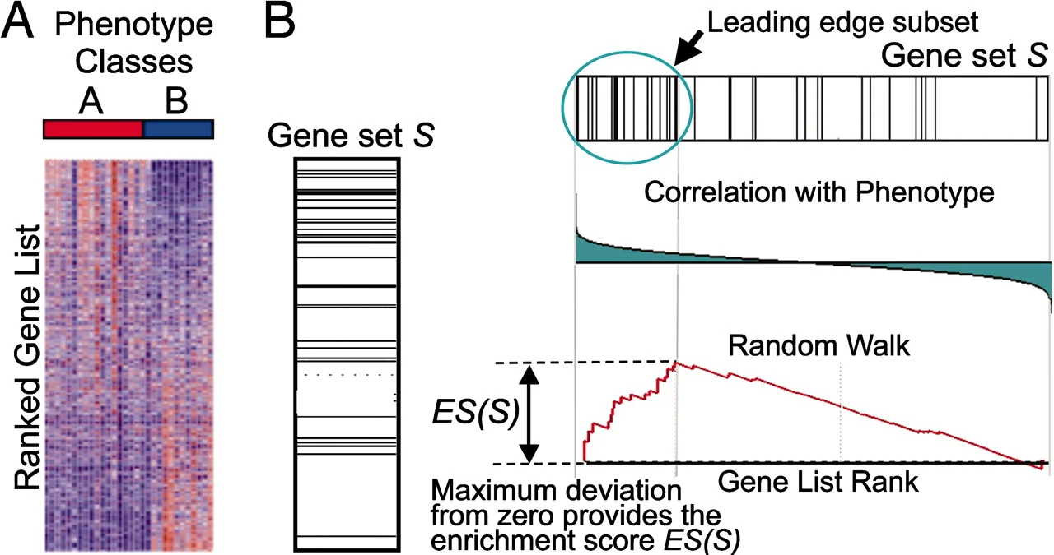
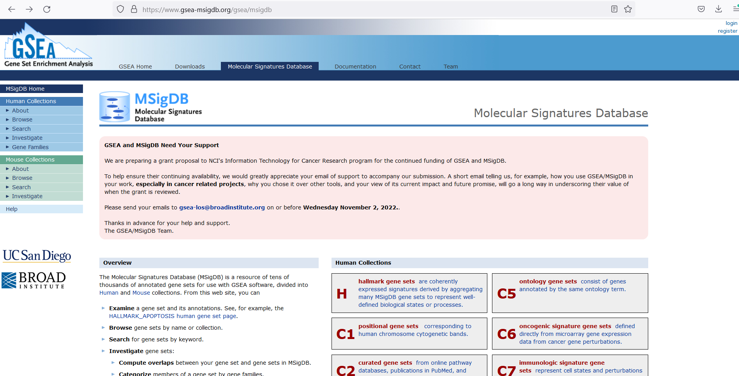
Gene set enrichment analysis overview
https://www.gsea-msigdb.org/gsea/msigdb
Subramanian et al. (2005)

Slide 38
Summary of over-representation analyses
Functional annotation of a DEG set looks for over-representation of genes from functional categories
This over-representation relies on the hypergeometric test
The hypergeometric test can be used to calculate overlaps between any custom sets
This is also known as the Fisher’s Exact test

